Slide 1
The System Conservation Pilot Program in Wyoming
Cory Toye
Wyoming Water and Habitat Program Director

Slide 2
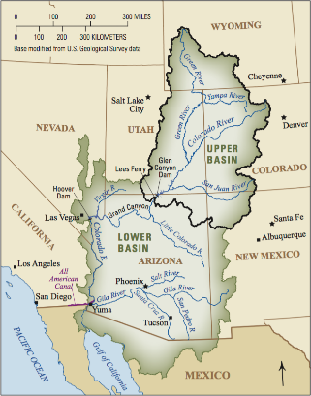
Colorado River Drainage

Slide 3
System Conservation Pilot Program (SCPP)
Facing the ongoing drought in the Colorado River Basin and declining reservoir levels, the BoR and four municipal water providers that depend on the CO River are developing tools that could be part of a drought contingency plan – including the SCPP.
The SCPP was designed to test on-the-ground, emergency water conservation opportunities:
Are there voluntary measures that could be used, when needed, to help maintain water levels in Lake Powell for CO River compact compliance and maintain hydropower generation?
Water users are monetarily compensated for actions that temporarily reduce consumptive use of CO River water.
Originally a 2 year pilot program slated to end in 2016, the overall success of the program prompted funding partners to extend the program through 2018.

Slide 4
SCPP in Wyoming
TU participated in the SCPP by soliciting the program to landowner partners in the Upper Green and in 2018, acted as a 3rd party for contracting and monitoring.
SEO offered technical assistance for completing applications, in particular, estimating consumptive use (CU) for each water conservation activity.
“Wyoming used remote sensed data (Landsat satellite imagery) with the energy balance model METRIC (Mapping EvapoTranspiration with High Resolution and Internalized Calibration).”
Successful applicants helped recruit more members.

Slide 5
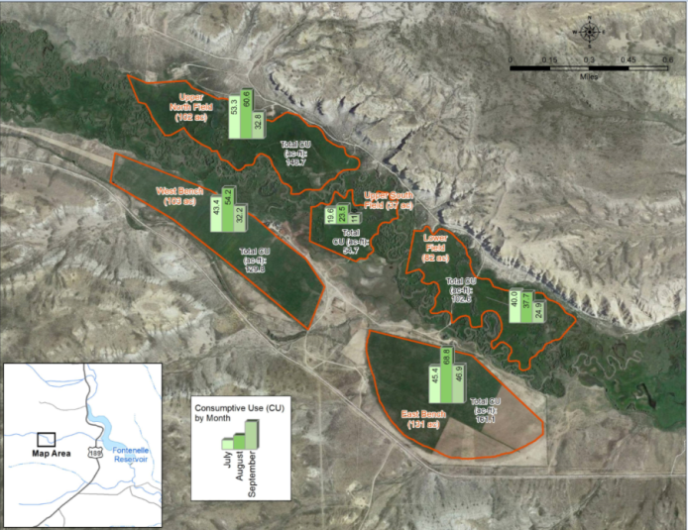
Wyoming SCPP 2015
Application period: May 11 to June 17, 2015

Slide 6
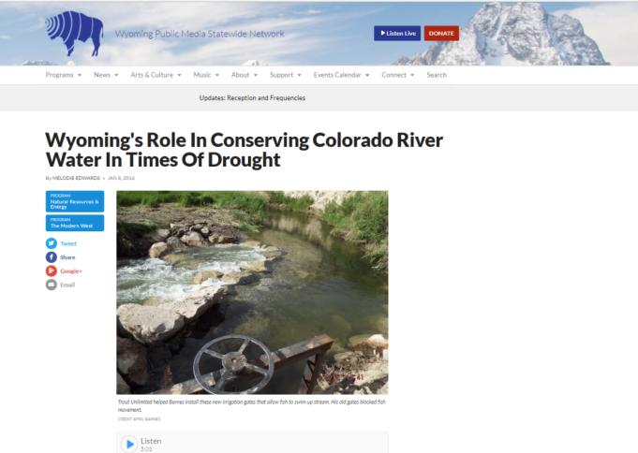
Wyoming SCPP 2016

Slide 7
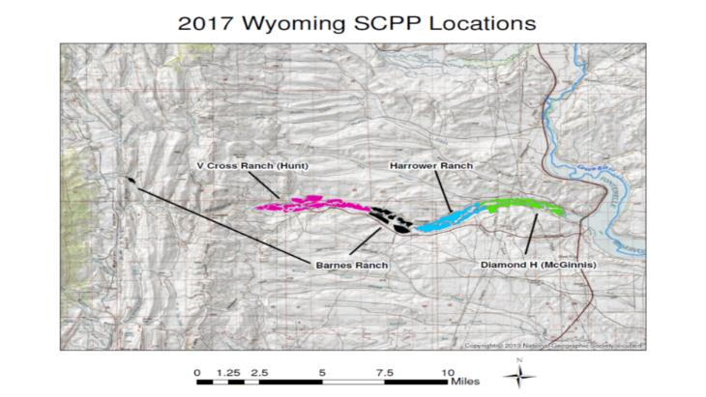
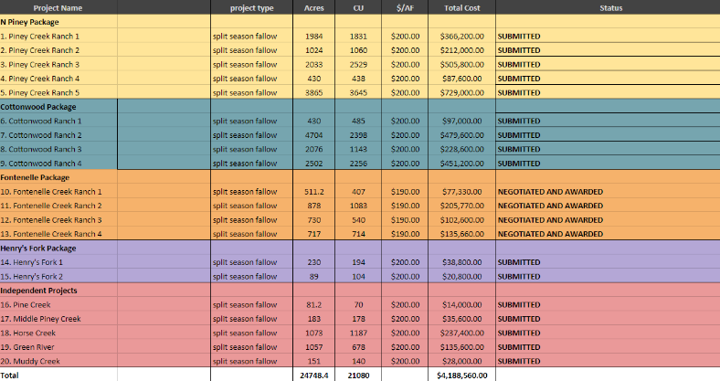
Wyoming SCPP 2017
2017 SCPP started emphasizing shepherding
Great recruitment of new water right holders
Total requests for funding across the upper basin = $7.5 million, total funding available: $1.8 million
Only 4 successful applications out of 20 in Wyoming

Slide 8
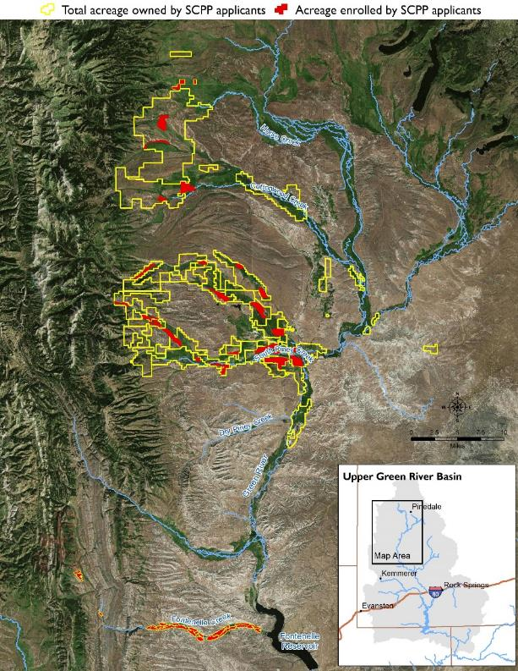
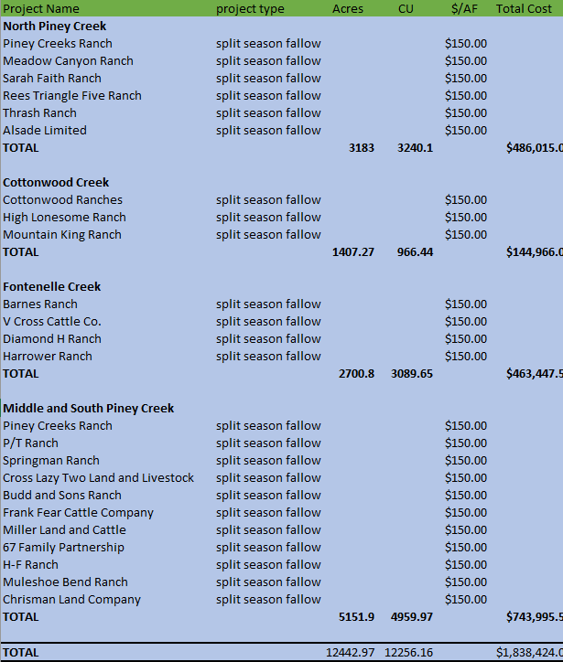
Wyoming SCPP 2018
Four tributaries with 95-100% participation
TU acting as 3rd party to administer agreement and funding
Acted as landowner agent
Realizing scale
Developing model for non regulatory shepherding
Cost continues to evolve

Slide 9
Next steps?
2020 Demonstration Projects
1. Understanding residual soil moisture during full or partial fallowing activities and how it relates to CU estimates.
2. Develop strategies to shepherd and account for conserved water generated through conservation activities.
3. Determine how different soil types and elevations effect CU.
4. Understand the impacts to producers for participation in water conservation activities as it relates to changes in groundwater elevations, yields, crop species composition and labor costs.
5. Determine how conservation activities effect streamflow.
6. Determine how irrigation efficiency activities effect streamflow.
7. Create strategies to develop a tributary wide models to conserve and deliver conserved water downstream.
8. Understand potential impacts of irrigation efficiency on wetlands, riparian areas and wildlife habitat for specific locations.

Slide 10
Lessons Learned and Transferability in other Wyoming Drainages
Landowner demand
Opportunity vs threat
Scale is available through collaboration
Voluntary, temporary, non regulatory
Shepherding is a group effort
Certainty for buyers and sellers is critical
Streamlining administration is required
The market for conserved water is evolving
These projects could benefit habitat for fish and wildlife with more water left in the stream in late summer months.

