Slide 1
Star Valley Local Work Group Meeting May 9, 2018 7:00 pm Afton, Wyoming
Notes:
District Board Meetings Local Work Group Meetings

Slide 2
Agenda
Welcome and Introductions
Purpose of the Local Work Group
Minutes – 2017 Local Work Group
Fiscal Year 2018 – EQIP Allocation to Div. III
Feedback / Recommendations
Prioritize Local Resource Priorities

Slide 3
LWG Purpose
LWG provides recommendations to NRCS and assigns resource priorities
LWG is advisory in nature
NRCS should give strong consideration to the LWG recommendations
Membership and participation should be diverse
Meetings are open to the public and must be advertised
Voting is not appropriate as this body is advisory

Slide 4
2017 Local Work Group Minutes

Slide 5
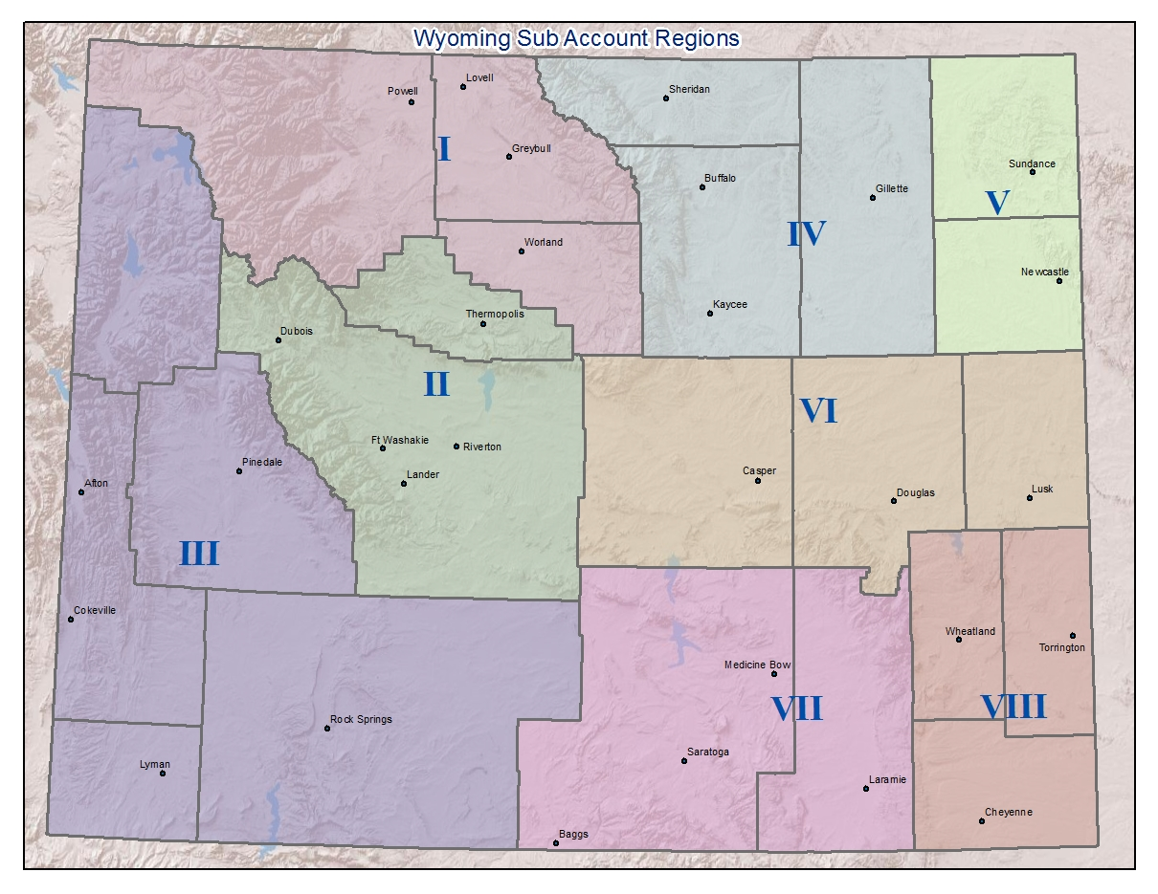

Slide 6
County Allocation Formula
# of Farms
# of Historically Underserved
Total, Private, Public, Irrigated Acres
Riparian/Wetland
# of At Risk Species
Implementation rate and other factors

Slide 7
2018 Environmental Quality Incentives Program (EQIP)
Southwest Wyoming Division Obligation = $1,268,303
Subaccount | Number of contracts | Total $ | % of Division Funds
Livestock: | 5 | $106,956 | 9*
Cropland: | 12 | $780,000 | 63
Water Delivery | 7 | $355,900 | 29
*Note: All applications within the livestock production account were funded.

Slide 8
Distribution of Division Funds By County - 2018
County | Obligation Amount | % of Division Funds
Sublette | $335,300 | 27
Lincoln | $785,356 | 63
Teton | $92,200 | 7
Uinta | $10,500 | 2
Sweetwater | $30,000 | 0

Slide 9
Other 2018 Funding
Subaccount | Number of contracts | Total $
EQIP – Wetland / Wildlife | 2 | $210,000
EQIP - Sage Grouse Initiative | 22 | $1,293,000
EQIP - Colorado Salinity | x | x
WaterSMART - Uinta | 1 | $47,000

Slide 10
Resource Priorities
Division 1 Resource Priorities | Star Valley | Division 3 Rank
Grazing Lands Management | 1 | 1
Water Quality | 2 | 3
Irrigation Water Management | 3 | 2
Forest Health | 4 | 7
Streambank/Riparian Area Protection | 5 | 4
Prevention of the Conversion of Agricultural Lands to Non-Agricultural Use | 6 | 9
Excessive Erosion | 7 | 6
Invasive Species | 8 | 5
Wetlands | 9 | 8
Soil Quality | 10 | 10
Fish and Wildlife Habitat | 11 | 11
Energy | 12 | 12

Slide 11
Feedback / Questions
SAM / DUNS
No Till Drills – Conservation Innovation Grants
NRCS Payment Method on Pivots

Slide 12
THANK YOU FOR YOUR PARTICIPATION!

